Slide 1

Adhi College of Engineering and Technology
Department of
Electronics and Communication Engineering
EC8551 COMMUNICATION NETWORKS

Slide 2
SYLLABUS
UNIT I FUNDAMENTALS & LINK LAYER
  Overview of Data Communications-Networks
  Building Network and its types
  Overview of Internet
  Protocol Layering
  OSI Mode
  Physical Layer
  Overview of Data and Signals
  introduction to Data Link Layer
  Link layer Addressing
  Error Detection and Correction
UNIT II MEDIA ACCESS & INTERNETWORKING
  Overview of Data link Control and Media access control
  Ethernet (802.3)
  Wireless LANs
  Available Protocols
  Bluetooth, Bluetooth Low Energy
  WiFi,6LowPAN,Zigbee,Network layer services
  Packet Switching,IPV4 Address
  Network layer protocols ( IP, ICMP, Mobile IP)
1.<number>

Slide 3
UNIT III ROUTING
  Routing
  Unicast Routing
  Algorithms
  Protocols
  Multicast Routing and its basics
  Overview of Intradomain and interdomain protocols
  Overview of IPv6 Addressing
  Transition from IPv4 to IPv6
UNIT IV TRANSPORT LAYER
  Introduction to Transport layer
  Protocols
  User Datagram Protocols (UDP) and
  Transmission Control Protocols (TCP)
  Services & Features
  TCP Connection
  State Transition Diagram
  Flow, Error and Congestion Control
  Congestion avoidance (DECbit, RED)
  QoS &Application requirements
1.<number>

Slide 4
UNIT V APPLICATION LAYER
  Application Layer Paradigms
  Client Server Programming
  World Wide Web and HTTP
  DNS
  Electronic Mail (SMTP, POP3, IMAP, MIME)
  Introduction to Peer to Peer Networks
  Need for Cryptography and Network Security
  Firewalls.
1.<number>

Slide 5
UNIT 1
Fundamentals & Link Layer
Notes:
1.#

Slide 6
OVERVIEW OF DATA COMMUNICATIONS
The term telecommunication means communication at a distance.
The word data refers to information presented in whatever form is agreed upon by the parties creating and using the data.
Data communications are the exchange of data between two devices via some form of transmission medium such as a wire cable.
1.<number>
Notes:
1.#

Slide 7
Components of data communication
  Message
  Sender
  Receiver
  Transmission Medium
  Protocol
1.<number>

Slide 8

Figure 1.1 Five components of data communication
1.<number>
Notes:
1.#

Slide 9

Elements of Communication
1.<number>

Slide 10
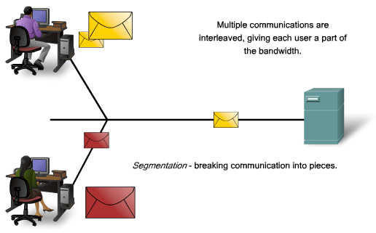
Communicating the Message
Segmentation
  divide the data into smaller, more manageable pieces called segments
  many different conversations can be interleaved on the network, giving each user a part of the bandwidth – multiplexing
  increases the reliability of network communications
Ch 2 - <number>

Slide 11
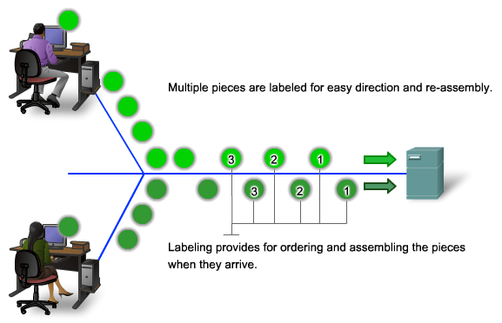
Addressing and Labeling the Segments
Segmenting and multiplexing a message requires additional processes
  addressing and labeling each segment at the source
  reassembling the segments into its original message at the destination
Ch 2 - <number>
Notes:
The downside to using segmentation and multiplexing to transmit messages across the network is the level of complexity that is added to the process.

Slide 12

Figure 1.2 Data flow (simplex, half-duplex, and full-duplex)
1.<number>
Notes:
1.#

Slide 13
NETWORKS
A network is a set of devices (often referred to as nodes) connected by communication links.
A node can be a computer, printer, or any other device capable of sending and/or receiving data generated by other nodes on the network.
1.<number>
Notes:
1.#

Slide 14
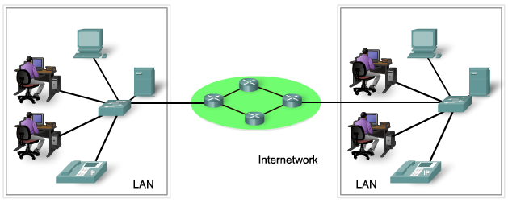
Components of the Network
Networks use devices, media and services
Hardware or physical elements
  devices and media
Software that run on the networked devices
  services such as applications and processes that provide the functionality to direct and move the messages through the network
Ch 2 - <number>

Slide 15
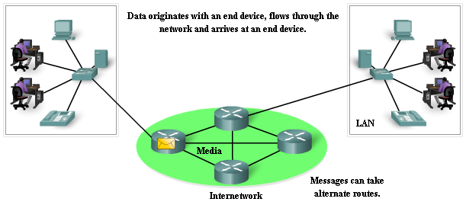
End Devices
An end device refers to a piece of equipment that is either the source or the destination of a message on a network
  the interface between the human and the network
  also known as a host
  each host is identified by an address
Ch 2 - <number>

Slide 16
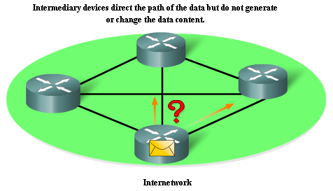
Intermediary Devices
Provide connectivity and ensures data flows across the network
Connect individual hosts to the network and can connect multiple individual networks to form an internetwork
Use the destination host address to determine the path the messages take through the network
Ch 2 - <number>
Notes:
Processes running on the intermediary network devices perform these functions:
Regenerate and retransmit data signals
Maintain information about what pathways exist through the network and internetwork
Notify other devices of errors and communication failures
Direct data along alternate pathways when there is a link failure
Classify and direct messages according to QoS priorities
Permit or deny the flow of data, based on security settings

Slide 17
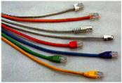
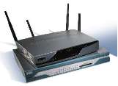
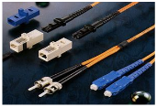
Network Media
Modern networks primarily use three types of media
  copper wires within cables
  glass or plastic fibers (fiber optic cable)
  wireless transmission
The signal encoding method is different for each media type
  data is encoded into electrical pulses on copper wires
  fiber optic transmissions rely on pulses of light, within either infrared or visible light ranges
  patterns of electromagnetic waves represent the various bit values in wireless transmission
Ch 2 - <number>

Slide 18
Network Types
LAN- Local Area Networks
MAN- Metropolitan Area Networks
WAN- Wide Area Networks
1.<number>

Slide 19
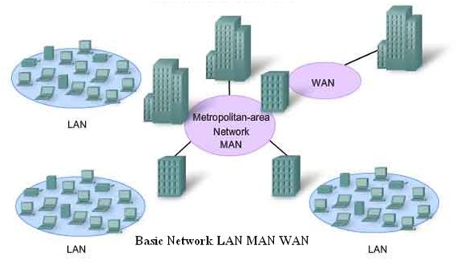
Network Types
1.<number>

Slide 20
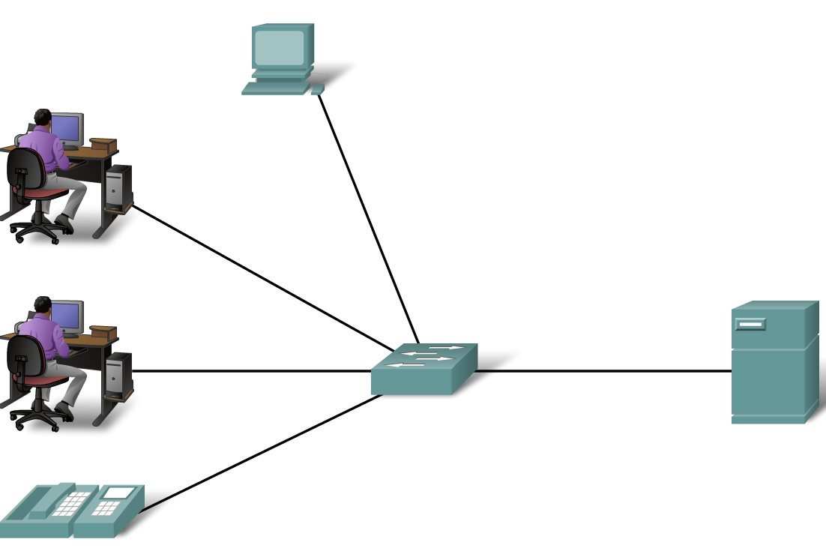
Network Types
Define Local Area Networks (LANs)
  A network serving a home, building or campus is considered a Local Area Network (LAN)

Slide 21
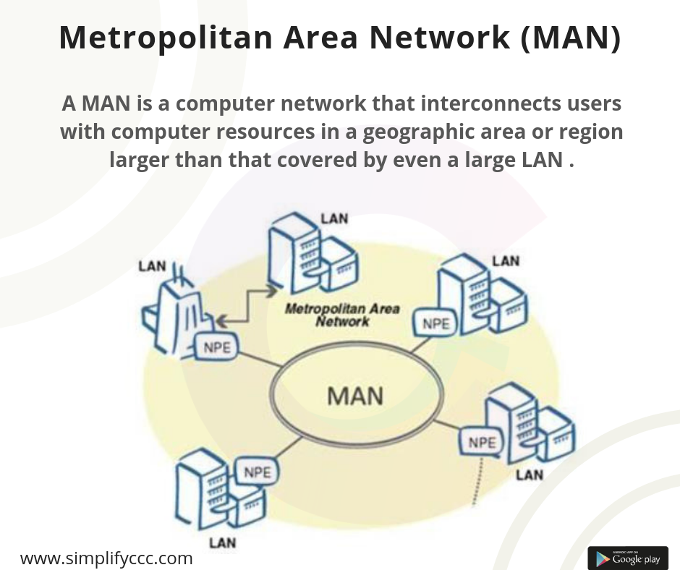
1.<number>

Slide 22
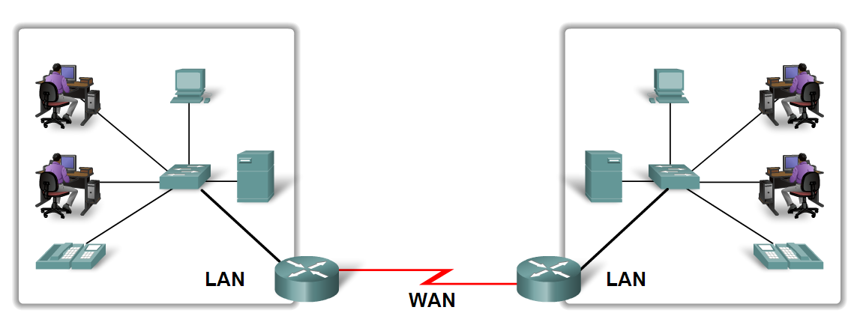
Network Types
Define Wide Area Networks (WANs)
  LANs separated by geographic distance are connected by a network known as a Wide Area Network (WAN)

Slide 23
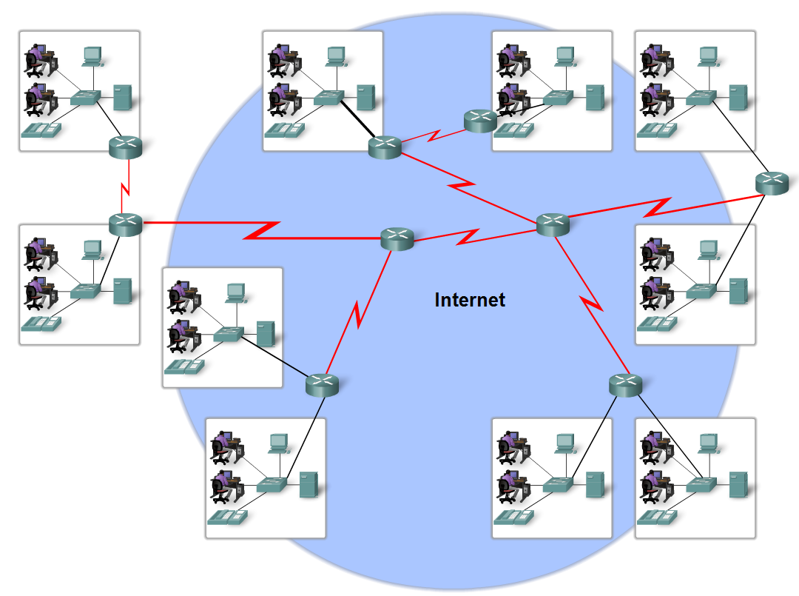
Network Types
Define the Internet
  The internet is defined as a global mesh of interconnected networks

Slide 24
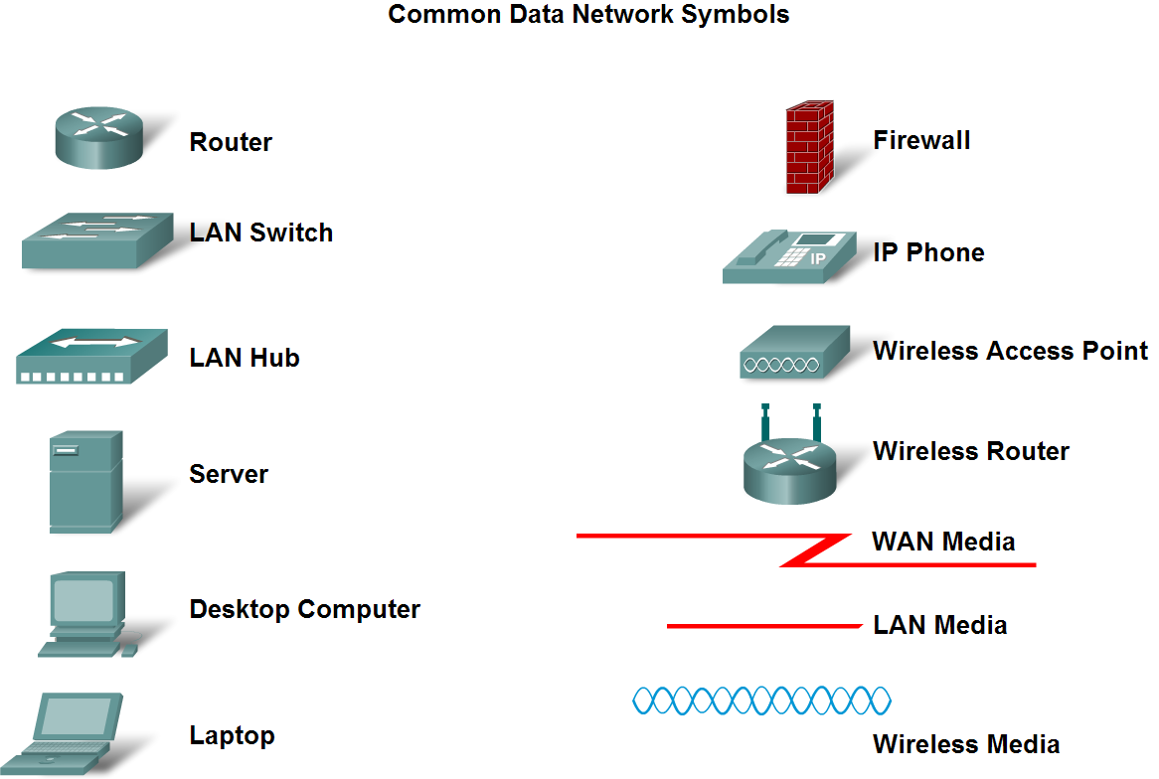
Network Types
Describe network representations

Slide 25
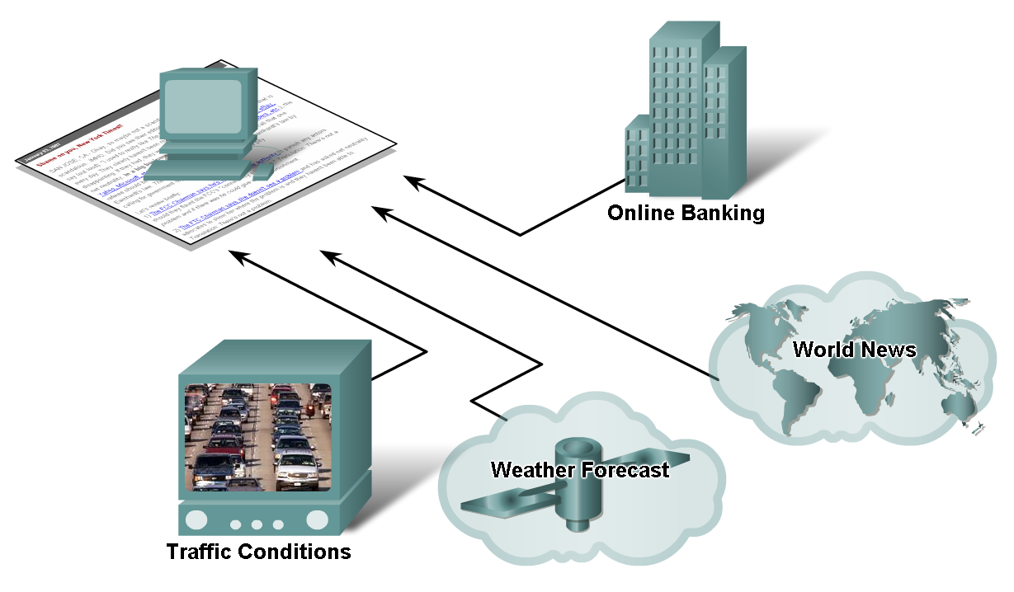
How Networks Impact Daily Life

Slide 26
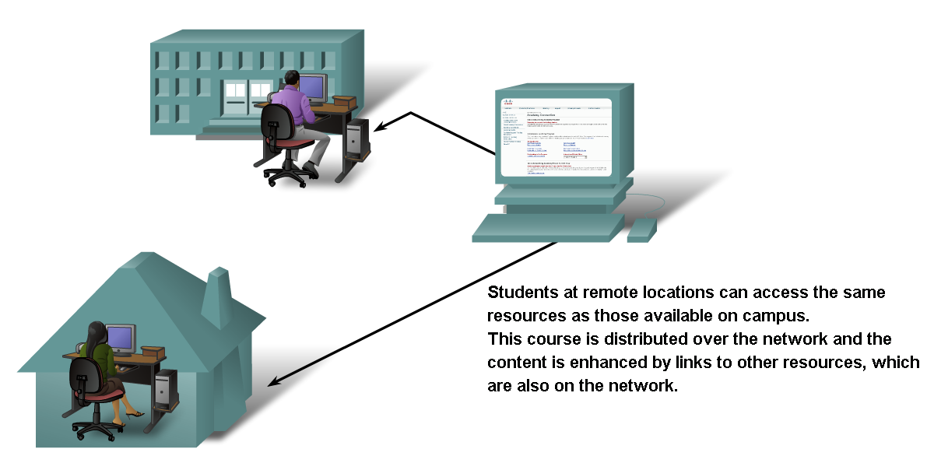
How Networks Impact Daily Life
information networks to share and collaborate improves teaching and learning

Slide 27
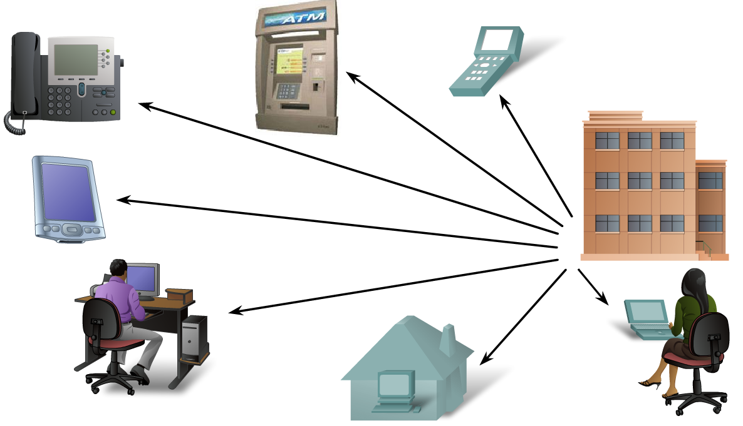
How Networks Impact Daily Life
Describe ways communication over a network changes the way we work

Slide 28
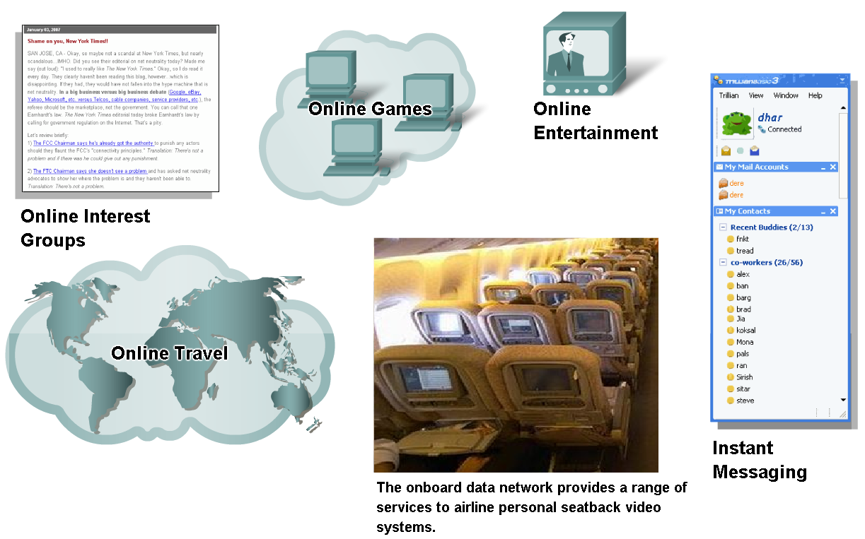
How Networks Impact Daily Life
Describe ways communication over a network supports the way we play

Slide 29
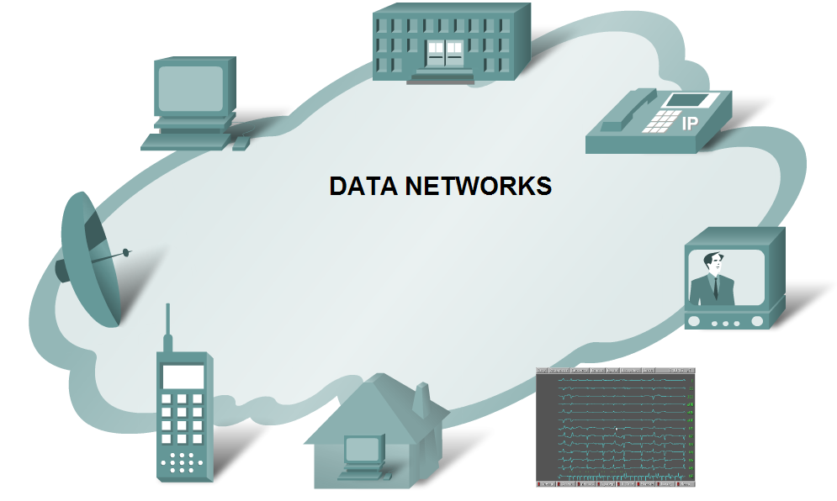
Data Networking Role, Components, and Challenges
Describe the role of data networking in communications

Slide 30
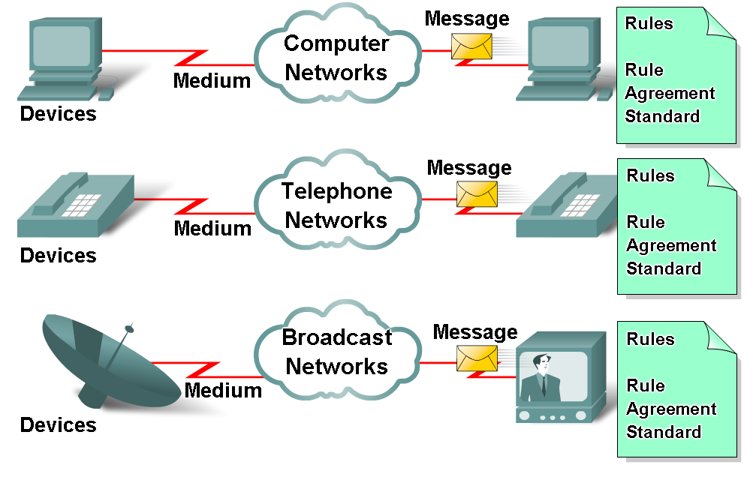
Data Networking Role, Components, and Challenges
Describe the various elements that make up a network
  Devices
    These are used to communicate with one another
  Medium
    This is how the devices are connected together
  Messages
    Information that travels over the medium
  Rules
    Governs how messages flow across network

Slide 31

Figure 1.3 Types of connections: point-to-point and multipoint
1.<number>
Notes:
1.#

Slide 32
Topology
  Topology is defined as “ geometrical arrangements of nodes or computers in a network”.
  Requirements of topology
    Flexible
    Cost
    Link failure
1.<number>

Slide 33

Figure 1.4 Categories of topology
1.<number>
Notes:
1.#

Slide 34

Figure 1.5 A fully connected mesh topology (five devices)
1.<number>
Notes:
1.#

Slide 35

Figure 1.6 A star topology connecting four stations
1.<number>
Notes:
1.#

Slide 36

Figure 1.7 A bus topology connecting three stations
1.<number>
Notes:
1.#

Slide 37

Figure 1.8 A ring topology connecting six stations
1.<number>
Notes:
1.#

Slide 38

Figure 1.9 A hybrid topology: a star backbone with three bus networks
1.<number>
Notes:
1.#

